Slide 1

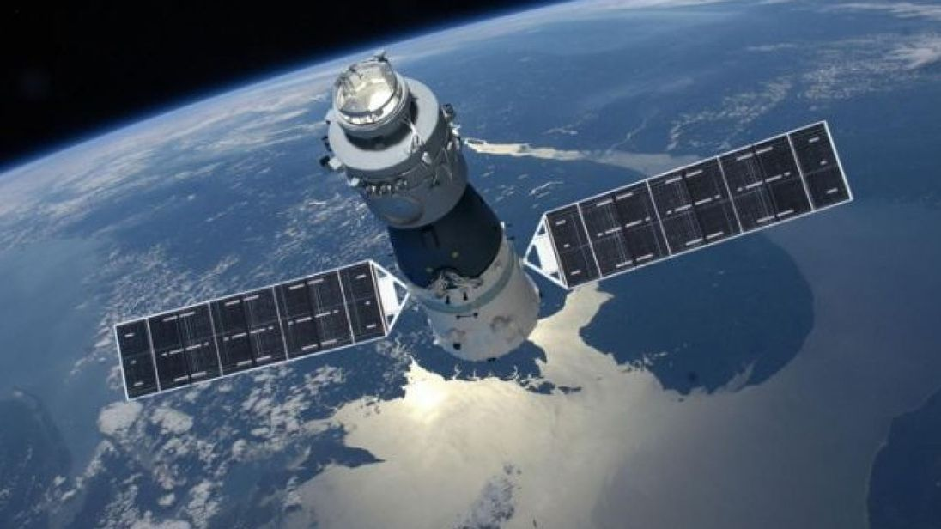
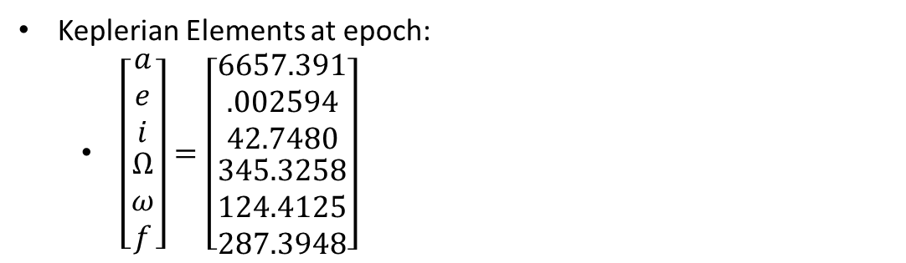

Recovery of the Tiangong 1 Spacecraft
Jacob Bailey
Gus Lee
Michael Lesnewski
INTRODUCTION
Lambert’s Method
Results
Conclusions
Background
The Chinese space station Tiangong 1 re-entered the Earth’s atmosphere and fell to its demise on April 2, 2018 over the South Pacific Ocean.
Project Objective:
Based on set of initial conditions ($R_{0},V_{0}),$ the space station’s orbit is to be propagated at least 30 days into the future. At which time an optimal maneuver is to be initiated in order to be the station back to initial orbit and saving it from its demise.
Initial Conditions
Software: How-to
Plots
References
Keplerian Elements at epoch:
$\left[\begin{matrix}\begin{matrix}a \\ e \\ i\end{matrix} \\ \begin{matrix}Ω \\ ω \\ f\end{matrix}\end{matrix}\right]=\left[\begin{matrix}\begin{matrix}6657.391 \\ .002594 \\ 42.7480\end{matrix} \\ \begin{matrix}345.3258 \\ 124.4125 \\ 287.3948\end{matrix}\end{matrix}\right]$
Inputs:
Tiangong 1’s initial position and velocity vectors at epoch
Additional inputs???
Outputs:
Total cost of the maneuvers (total ΔV)
Additional outputs???
Describe how to use our code…..

